Slide 1
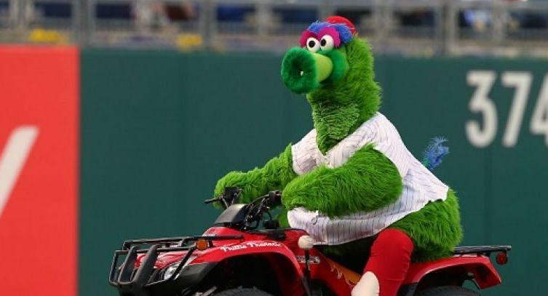
Take Me Out to the Ball Game
and partner song,
Which Ball Game?

Slide 2
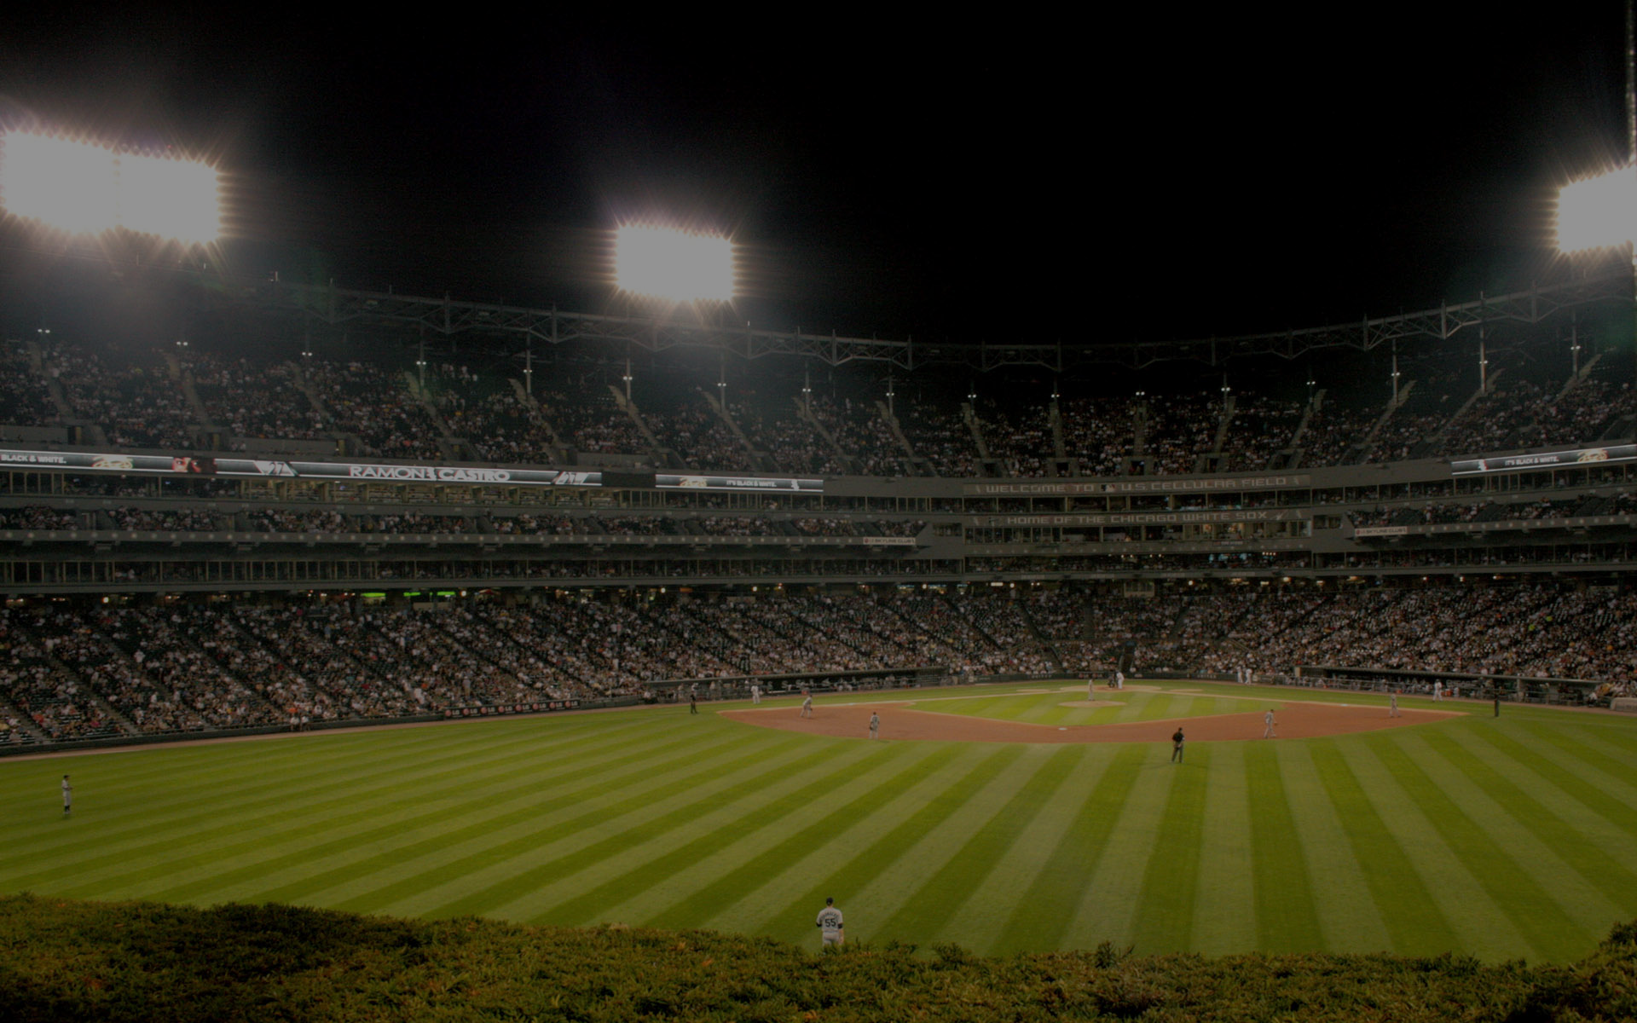
Take Me Out to the Ball Game
Vocal Track
Accomp
Take me out to the ball game.
Take me out with the crowd.
Buy me some peanuts and Cracker Jack.
I don’t care if I never get back.
Let me root, root, root for the home team;
If they don’t win it’s a shame.
For it’s one, two, three strikes, you’re out
at the old Ball Game!

Slide 3
Which Ball Game?
Oh… how… I love a football game.
I… like… to yell with the crowd.
Watch as they knock that team on their back.
Rushing the quarterback; * it’s a sack!
Pass… it… into the end zone; a
Kick through the goal post and we’ve won the game.
*One, two, *three, four, *downs to go at the
Football game!

Slide 4
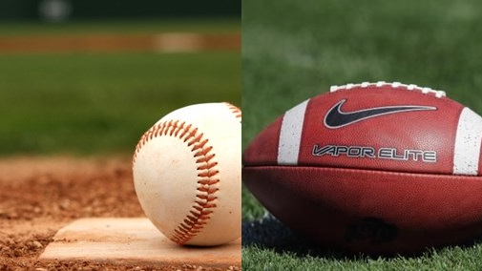
Take me out to the ball game.
Take me out with the crowd.
Buy me some peanuts and Cracker Jack.
I don’t care if I never get back.
Let me root, root, root
for the home team;
If they don’t win it’s a shame.
For it’s one, two, three strikes, you’re out
at the old Ball Game!
Oh, how I love a football game.
I like to yell with the crowd.
Watch as they knock that
team on their back.
Rushing the quarterback:
it’s a sack!
Pass it into the end zone; a
kick through the goal post and we’ve won the game.
One, two, three, four,
downs to go at the
football game!

